Slide 1
CAPITAL BUDGETING
Notes:
Financial intelligence is all about understanding how the financial side of business works and how financial decisions are made. Here the point of discussion is related to capital investment decisions.

Slide 2
Capital Budgeting
Planning and controlling decisions for projects affecting financial results more than 1 year
Requires investments of large amounts of resources in anticipation of future benefits
Capital Budgeting is long-term planning for making and financing such outlays

Slide 3
Capital Budgeting Process
Identification of potential investment opportunities
Assembling of proposed investments
Decision Making
Preparation of Capital Budget and appropriations
Implementation
Performance Review

Slide 4
Project Classification
Mandatory Investments
Replacement Projects
Expansion Projects
Diversification Projects
R&D Projects
CSR Projects
Miscellaneous Projects

Slide 5
Investing Criteria
NPV
The Payback Period
Internal Rate of Return
Capital Rationing

Slide 6
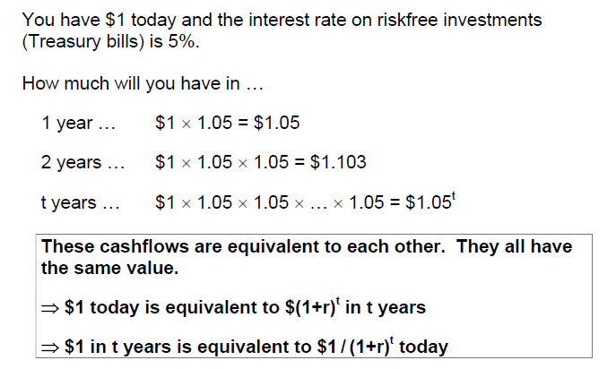
Time value of money
Basic principle of Finance: A rupee today is worth more than a rupee tomorrow, because the rupee today can be invested to start earning interest immediately.

Slide 7
3 Key Concepts
Future value
Present Value
Required rate of return

Slide 8
Present Value
Present Value
Value today of a future cash flow.
Discount Factor
Present value of a Re.1 future payment.
Discount Rate
Interest rate used to compute present values of future cash flows.

Slide 9
Present Value

Slide 10
Present Value
Discount Factor = DF = PV of Re.1
Discount Factors can be used to compute the present value of any cash flow.

Slide 11
Example
Your firm spends $800,000 annually for electricity at its Boston headquarters. A sales representative from Johnson Controls wants to sell you a new computer-controlled lighting system that will reduce electrical bills by roughly $90,000 in each of the next three years. If the system costs $230,000, fully installed, should you go ahead with the investment?
Lighting system
Year 0 1 2 3
Cashflow -230,000 90,000 90,000 90,000
$270,000

Slide 12
Example, cont.
Assume the cost savings are known with certainty and the discount rate is 4%.
Year 0 1 2 3
Cashflow -230,000 90,000 90,000 90,000
÷ 1.04 1.04² 1.04³
PV -230,000 86,538 83,210 80,010
Net present value
NPV = -230,000 + 86,538 + 83,210 + 80,010 = $19,758
$249,758
Go ahead.

Slide 13
Valuing an Office Building
Step 1: Forecast cash flows
Cost of building = C₀ = 350
Sale price in Year 1 = C₁ = 400
Step 2: Estimate opportunity cost of capital
If equally risky investments in the capital market
offer a return of 7%, then
Cost of capital = r = 7%

Slide 14
Valuing an Office Building
Step 3: Discount future cash flows
Step 4: Go ahead if PV of payoff exceeds investment

Slide 15
Risk and Present Value
Higher risk projects require a higher rate of return.
Higher required rates of return cause lower PVs.

Slide 16
Risk and Present Value

Slide 17
Fundamental principle
A safe rupee is worth more than a risky one
The value of any asset or investment equals the Net Present Value (NPV) of the expected cashflows.
Risk should be incorporated into r
The discount rate for the investment equals the rate of return that could be earned on an investment in the financial markets with similar risk.
r = ‘opportunity cost of capital’ or ‘required rate of return’
A project creates value only if it generates a higher return than similar investments in the financial market.

Slide 18
Applications
(1) Diversifying investments
You work for AT&T, a telecom company. Your boss asks you to evaluate a possible merger with NCR, a large computer manufacturer.
As part of the analysis, you need to come up with an appropriate discount rate for valuation. Investors generally require a 10% return on investments in AT&T.
What is the cost of capital for the merger?
10% represents the cost of capital for investments in telecom services. It is not appropriate for an investment in the computer industry. Need to estimate the cost of capital required by computer firms.

Slide 19
Applications
(2) Multiple divisions
You work for a large, diversified company. Last year, approximately 30% of profits came from auto parts, 30% came from electronics, and 40% came from financial services.
Your boss asks you to evaluate a proposed growth opportunity in financial services. You estimate the firm’s cost of capital is 11%. Is this the appropriate discount rate to use for the proposed investment?
No. 11% is really an average cost of capital for the firm. Each division should use a separate discount rate, reflecting the risk of that division. Estimate by comparing to firms in each of the three industries.

Slide 20
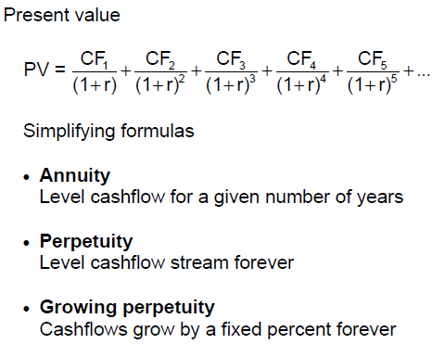
Shortcut formulas

Slide 21
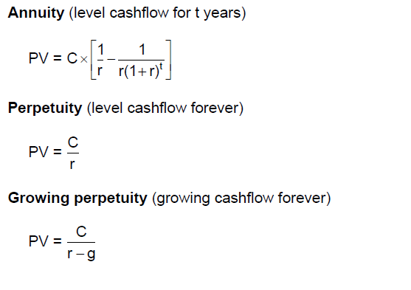
Shortcut formulas

Slide 22
Example
Firms in the S&P 500 are expected to pay, collectively, $20 in dividends next year. If growth is constant, what should the level of the index be if dividends are expected to grow 5% annually? 6% annually? Assume r = 8%.

Slide 23
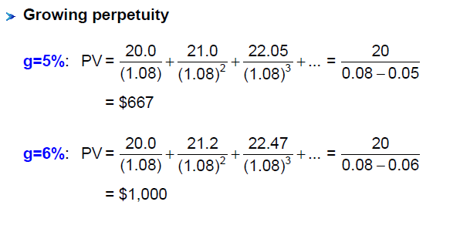

Slide 24
Example
You just moved to Boston and, after seeing the affordable prices, decide to buy a home. If you borrow $800,000, what is your monthly mortgage payment? The interest rate on a 30-year fixed-rate mortgage is 5.7% (or 0.475% monthly, 5.7% / 12)

Slide 25
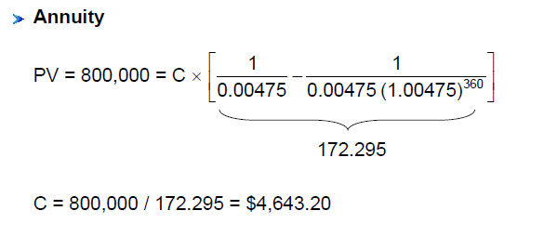

Slide 26
Why Net Present Value Leads to Better Investment Decisions than Other Criteria

Slide 27
Properties of NPV
Cashflows
NPV is based on cashflows and explicitly measures value. It is flexible enough to take into account strategic issues.
Timing and risk
NPV recognizes that cash received in the future is worth less than cash today, and that risky cashflows are worth less than safe cashflows.
Objective
NPV is objective. Take all projects with NPV > 0 because these create value.

Slide 28
Payback
The payback period of a project is the number of years it takes before the cumulative forecasted cash flow equals the initial outlay.
The payback rule says only accept projects that “payback” in the desired time frame.
This method is very flawed, primarily because it ignores later year cash flows and the present value of future cash flows.

Slide 29
Payback
Example
Examine the three projects and note the mistake we would make if we insisted on only taking projects with a payback period of 2 years or less.

Slide 30
Payback
Example
Examine the three projects and note the mistake we would make if we insisted on only taking projects with a payback period of 2 years or less.

Slide 31
Internal Rate of Return (IRR)
IRR is the discount rate which makes the NPV zero.
IRR is an alternative method of evaluation, which compares the required rate of return and actual rate of return
If, IRR > Discount rate , Accept the project
< Discount rate, Reject the project

Slide 32
Internal Rate of Return
Example
You can purchase a turbo powered machine tool gadget for $4,000. The investment will generate $2,000 and $4,000 in cash flows for two years, respectively. What is the IRR on this investment?
Notes:
32

Slide 33
Internal Rate of Return
Example
You can purchase a turbo powered machine tool gadget for $4,000. The investment will generate $2,000 and $4,000 in cash flows for two years, respectively. What is the IRR on this investment?
Notes:
33

Slide 34
Internal Rate of Return
Example
You can purchase a turbo powered machine tool gadget for $4,000. The investment will generate $2,000 and $4,000 in cash flows for two years, respectively. What is the IRR on this investment?
Notes:
34

Slide 35
Internal Rate of Return
IRR=28%
Notes:
35

Slide 36
Internal Rate of Return
Pitfall 1 - Lending or Borrowing?
With some cash flows (as noted below) the NPV of the project increases as the discount rate increases.
This is contrary to the normal relationship between NPV and discount rates.
The IRR rule must be reversed for a project with an initial cash inflow, CF0 > 0.
CF⁰ = 100,000, CF¹ = –120,000
Notes:
36

Slide 37
Internal Rate of Return
Pitfall 1 - Lending or Borrowing?
With some cash flows (as noted below) the NPV of the project increases as the discount rate increases.
This is contrary to the normal relationship between NPV and discount rates.
NPV
Discount Rate
Notes:
37

Slide 38
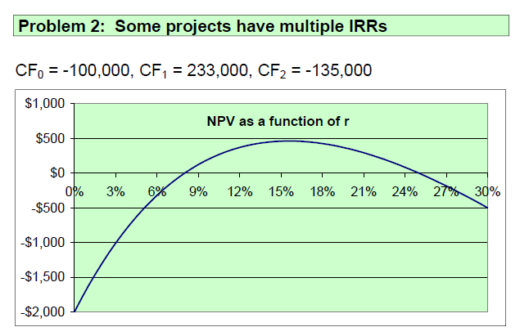

Slide 39
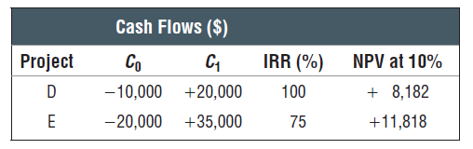
Pitfall 3 - Mutually Exclusive Projects
IRR sometimes ignores the magnitude of the project.
The following two projects illustrate that problem.

Slide 40
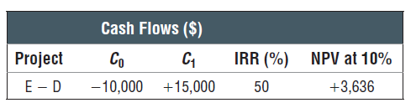
IRR on Incremental Cash Flows

Slide 41
Capital Rationing: Profitability Index
When resources are limited, the profitability index (PI) provides a tool for selecting among various project combinations and alternatives.
A set of limited resources and projects can yield various combinations.
The highest weighted average PI can indicate which projects to select.

Slide 42
Profitability Index
Example
We only have $300,000 to invest. Which do we select?
Proj PV Investment PI
A 230,000 200,000 1.15
B 141,250 125,000 1.13
C 194,250 175,000 1.11
D 162,000 150,000 1.08

Slide 43
Profitability Index
Example - continued
Proj PV Investment PI
A 230,000 200,000 1.15
B 141,250 125,000 1.13
C 194,250 175,000 1.11
D 162,000 150,000 1.08
Select projects with highest Weighted Avg PI
WAPI (BD) = 1.13(125) + 1.08(150) + 1.0 (25)
(300) (300) (300)
= 1.09

Slide 44
Profitability Index
Example - continued
Proj PV Investment PI
A 230,000 200,000 1.15
B 141,250 125,000 1.13
C 194,250 175,000 1.11
D 162,000 150,000 1.08
Select projects with highest Weighted Avg PI
WAPI (BD) = 1.09
WAPI (A) = 1.10
WAPI (BC) = 1.12

